Slide 1

ER.PERUMAL MANIMEKALAI COLLEGE OF ENGINEERING
Department of Electronics and Communication Engineering
Customer Care Registry
Domain: Cloud App Development Team ID: PNT2022TMID30039
REENA.K
PREMA.T
ABINAYA.S
MEENA.P
Page 01

Slide 2
PRESENTATION CONSPECTUS
INTRODUCTION
OBJECTIVE
ABSTRACT
LITERATURE SURVEY
EXISTING METHODS AND DEMERITS
PROPOSED SYSTEM AND MERITS
PROPOSED SYSTEM BLOCK DIAGRAM
TECHNICAL ARCHITECTURE
HARDWARE COMPONENTS
EXPERIMENTAL SETUP
EXPECTED OUTPUT
FUTURE ENHANCEMENT
GANTT CHART
REFERENCES
06/10/2022
Page 02

Slide 3
INTRODUCTION
.
The prevalent view in various global circles is that man is presently living in an age growth of information gathering, processing and dissemination, popularly called the information age. For this reason, managers and other users of information especially in transport industries are demanding more kinds of information to support management, problem solving their issues and operations. They must therefore respond to the increasing requirement for information and data management through the cloud technology. Electronic tickets, or e-tickets, gives evidence that their holders have the permission to enter a place of entertainment, use a means of transportation, or have access to some Internet services. The design of this online system will be beneficial to the company because it has not existed before and was not able to solve customers’ issues. The ultimate expectation is to inspire a feasibility study aimed at providing proper guidance and awareness to any future potential investors and to solve the customers problem, to buy train ticket, make payment, and ask for information online easily. And staffs can solve problem of customer through the mail form and they can also check the details of ticket and if the customers find any kind of complain they can easily register them complain through mail. The agent who will respond to each and every complain through the cloud technology.
06/10/2022
Page 03

Slide 4
ABSTRACT
YOUR COMPANY x CLIENT
Online TRAIN Ticket Reservation System is a cloud-based application that works within a centralized network. This project presents a review on the software program “Online TRAIN Ticket Reservation System” as should be used in a TRAIN transportation system, a facility which is used to reserve seats, cancellation of reservation, customer complain and different types of route enquiries used on securing quick reservations. OBTRS is built for managing and computerizing the cloud database, ticket booking and tracking TRAIN and travel made. It maintains all customer details; TRAIN details and customer complain. In addition, HTML Hypertext Markup language was used for the front- end of the software while the back end was designed using python. The software achieved is capable of improving the customer hand and customers complains with cloud operations. It is recommended that despite the present functionality of the designed software, an additional functionality such as the use of E-mail to send tickets and notifications to the customer and customer complaints with cloud technology.
06/10/2022
Page 04

Slide 5
PROBLEM STATEMENT
Providing a web-based train ticket reservation function where a customer can buy train ticket through the online system without a need to queue up at the counter to purchase a train ticket.
Enabling customers to check the availability and types of trainees online. Customer can check the time departure for every train through the system.
Ability of customers to complain their reservation.
Admin user privileges in of complain at time and will receives the solution for complain and problem.
06/10/2022
Page 05

Slide 6
LITERATURE SURVEY
S. NO | TITLE | PROPOSED WORK | TOOLS USED/ ALGORITHM | TECHNOLOGY | ADVANTAGES/ DISADVANTAGES
 |  |  |  |  | 1.This proposes a robust,
 |  |  |  |  | scalable, and extensible
 |  |  |  |  | architecture with a
1 | REAL WORLD SMART CHATBOT FOR CUSTOMER CARE USING A SOFTWARE AS A SERVICE (SAAS) ARCHITECTURE | This journal employ chatbot for customer care. This is done by providing a human way interaction using LUIS and cognitive services. | •AWS Public Cloud •AWS Lambda •API Gateway •LUIS •Ejabberd •Chatbot | •Cloud Computing •Machine Learning | technology stack consisting of the Ejabberd Server. 2.The Ejabberd server makes creates the room functionality where the customer needs to be
 |  |  |  |  | persistent over time in
 |  |  |  |  | that room
2 | AN INTELLIGENT CLOUD BASED CUSTOMER RELATIONSHIP MANAGEMENT SYSTEM TO DETERMINE FLEXIBLE PRICING FOR CUSTOMER RETENTION | This paper proposes that the customer are categorized based on purchase behaviors, historical ordering patterns and frequency of purchase customized customer care and promotions are given. | •Intelligent Cloud- based Customer Relationship Management | •Cloud Computing •Artificial Intelligence | 1.Customer care is given based upon purchase behaviors, features of the product purchased without any interaction
06/10/2022
Page 06

Slide 7
LITERATURE SURVEY
S. NO | TITLE | PROPOSED WORK | TOOLS USED/ ALGORITHM | TECHNOLOGY | ADVANTAGES/ DISADVANTAGES
3 | CHATBOT FOR CUSTOMER SERVICE | In this paper customer trust chatbots to provide the required support. Chatbots represent a potential means for automating customer service. | •Chatbot •Java Script | •Cloud Computing •Artificial Intelligence •Machine Learning | 1.This provides automated customer service with the use of the cloud.
4 | IMPLEMENTING CONTINUOUS CUSTOMER CARE | In this paper, we employ the software as a service (SaaS) model which introduces drastic improvement to the situation, as the service provider can now have direct access to the user data and analyze it if agreed appropriately with the customer. | •Java Script •HTML •Google Analytics | •Artificial Intelligence •Machine Learning | 1.Feedback loops are used that allow the service provider to capture feedback at the point of experience. One way to find out is to conduct continual end- user experience monitoring to determine if users are happy 2.It is not always easy for SaaS providers to know what customers are experiencing.
06/10/2022
Page 07

Slide 8
LITERATURE SURVEY
S. NO | TITLE | PROPOSED WORK | TOOLS USED/ ALGORITHM | TECHNOLOGY | ADVANTAGES/ DISADVANTAGES
5 | IMPLEMENTATION OF CLOUD CUSTOMER RELATIONSHIP MANAGEMENT IN BANKING SECTOR: STRATEGIES, BENEFITS AND CHALLENGES | The cloud customer relationship management (CRM) has emerged as an innovative tool to augment the customer satisfaction and performance of banking systems. Cloud CRM allows to collect, analyze and utilize customer- associated information and update the systems. | •Cloud CRM Strategy •AWS Cloud | •Cloud Computing •Mobile Computing | This proposes a robust, scalable, and extensible architecture with a technology stack consisting of the Ejabberd Server. The Ejabberd server makes creates the room functionality where the customer needs to be persistent over time in that room
 |  | This journal Chatbots for |  |  | 1.Maintain Flexibility
6 | ARTIFICIAL INTELLIGENCE REPLACING HUMAN CUSTOMER SERVICE | customer care registry using Artificial intelligence. This assists consumers in decision making. Based on the computers-are-social- actors paradigm | •Chatbots •Python •Mongo DB | •Cloud Computing •Artificial Intelligence •Machine Learning | and focus on their customers. 2.The use of chatbots in service interactions may raise greater consumer concerns regarding privacy risk issues.
06/10/2022
Page 08

Slide 9

EXISTING METHOD & DEMERITS
The is a cloud-based customer care system that offers powerful solutions for customer service. The existing unifies conversations from email, phone, web, chat, and social, and helps you resolve issues across channels effortlessly.
The online ticketing system simplifies your team's work. It's full of features that foster collaboration within your team. You can use tagging, add private notes, assign tickets to specific team members and create canned responses.
Some Commonly Used Customer Care Registry
DEMERITS
Emails get caught in Spam sometimes when they aren’t spamming.
There is an obvious lack of control over training, nuances can be lost. Customers may find it too impersonal.
Tickets sometimes get lost, and following a ticket doesn't support me much. Also, tickets can get lost when transferred to another team.
About creating passwords that are mostly a problem in this software.
06/10/2022
Page 09

Slide 10
PROPOSED SYSTEM & MERITS
Assigned Agent routing can be solved by directly routing to the specific agent about the issue using the specific Email. Automated Ticket closure by using daily sync of the daily database. Status Shown to the Customer can display the status of the ticket to the customer.
Maintaining a history of the previous issues that the customer faced in the database. To provide online support to its customers on a 24×7 basis.
MERITS
The customer can raise issues regarding any sector whether it can be a Banking sector, Network sector, social issue, Product based, or political based.
The updates and status of the issue will not only be shared through E-mail but also through Social Media Apps and Messages.
Automated Ticket Closure, Status Shown to the Customer
06/10/2022
Page 10

Slide 11

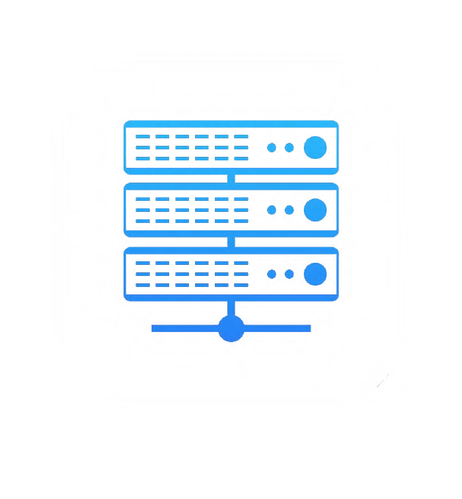



PROBLEM ARCHTIECHURE
Server-Side
Client-Side
SERVER
HTTP GET Request
Static Resources
1. CSS
Script Image
FILES | 2. Java
HTML Templates
HTTP Response
BROWSER
Request Data
URL Encoding
GET/POST Data
Data
HTML
DATABASE
WEB APPLICATION
06/10/2022
Page 11

Slide 12
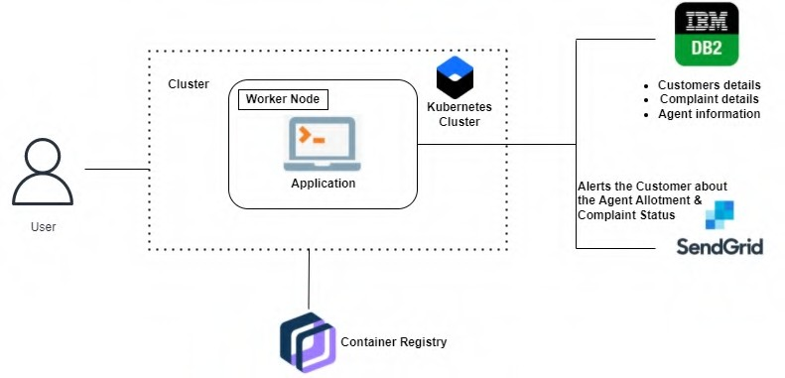
TECHNICAL ARCHITECTURERE
06/10/2022
Page 12

Slide 13
HARDWARE REQUIREMENTS
8GB RAM,
Intel Core i3,
OS-Windows/Linux/MAC
Laptop or Desktop
SOFTWARE REQUIREMENTS
Python
Flask
Docker
06/10/2022
Page 13

Slide 14
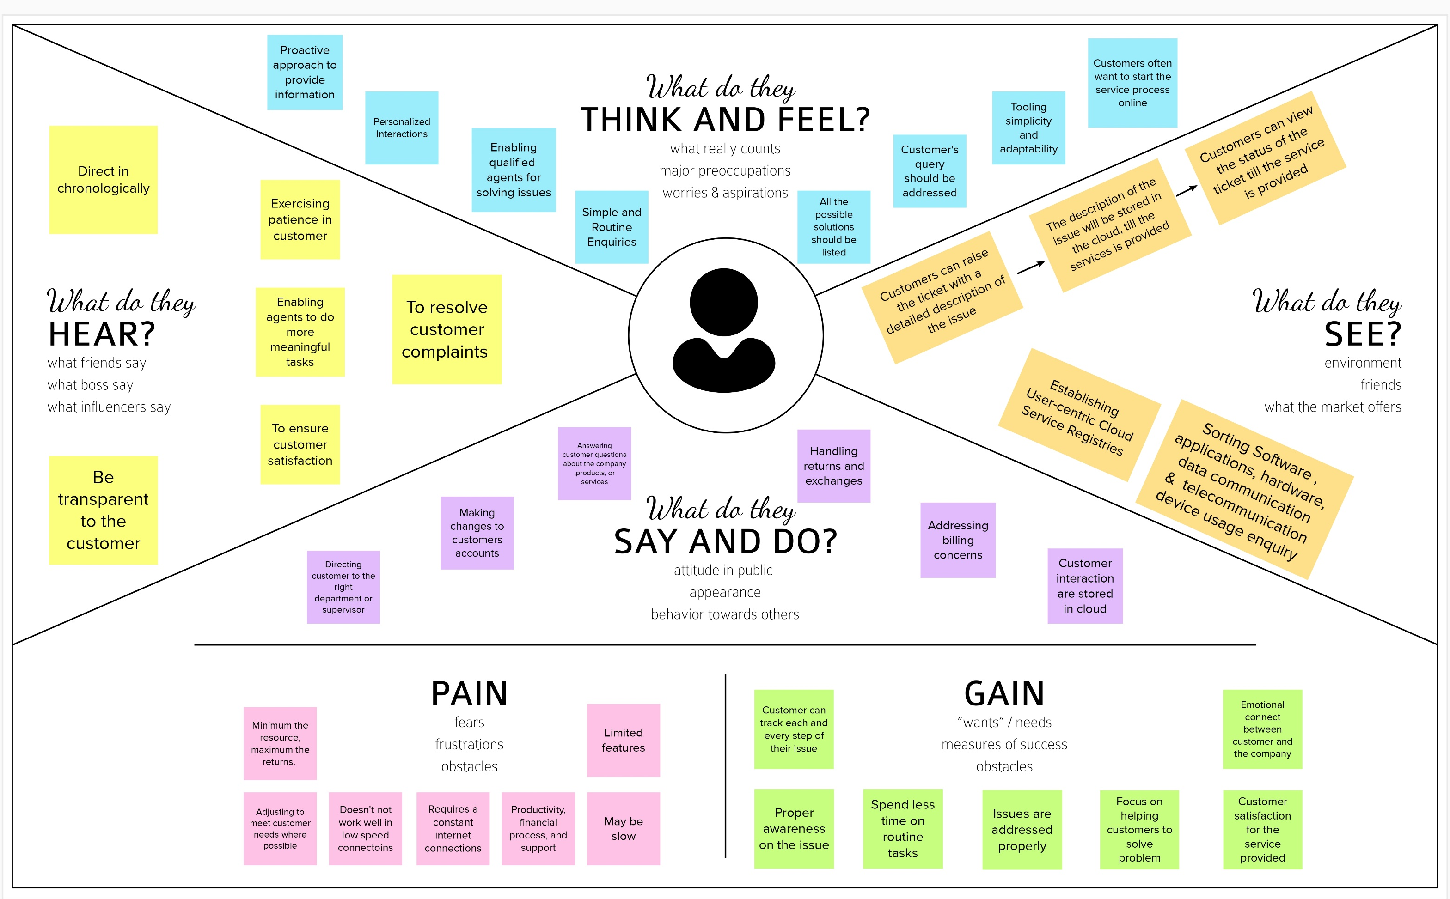
EMPATHY MAP
06/10/2022
Page 13

Slide 15
GANTT CHART
Activity
Ideation Phase
Setting Up Application Environment
Project Design Phase – I
Project Design Phase – II
Project Planning Phase
Implementing Web Application
Integrating SendGrid Service
Deployment Of App In IBM Cloud
Project Development Phase
Time in Weeks
1 | 2 | 3 | 4 | 5 | 6 | 7 | 8 | 9 | 10 | 11 | 12
06/10/2022

Slide 16
REFERENCES
[1] Madden A .D., (2000): "A definition of information", Aslib Proceedings, Vol. 52 Iss: 9, pp.343 – 349
[2] Badre, A. (2002): Shaping Web Usability. Boston: Pearson Education, Inc.
[3] Banfield, E. G. (1989): International Social Science. New York: Vander
[4] Buschmann, .F., Meunier .R., Rohnert H., Sommerlad P., and Stal M. (1996): Pattern-oriented Software Architecture.London: SAGE Publication California: Mayfield Publishing Company.
[5] Cunningham, W. G. (1982): Systematic Planning for Educational Change. Eckermann, E. (2001): World History of the Automobile, SAE, pp. 67–68, ISBN 9780768008005, retrieved October 6, 2013).
[6] Fernando Pedone ( 2001): Optimistic Validation of Electronic Tickets.20th IEEE Symposium on Reliable Distributed Systems (SRDS'2001) [BibTeX]
[7] Flick, U. (2009): An Introduction to Qualitative Research. London: SAGE
[8] Hevner A., March S., Park J., and Ram, S. (2004): Design Science in Information Systems Research. MIS Quarterly.
[9] Kevin O. C., (2012): Web-Based Bus Reservation and Ticketing System: College of Computer Studies, Ateneo de Naga University, Naga City, Philippines February 26, 2012
[10] Laweb,(2010): "Central Reservation System | Online Hotel Marketing Services, Hong Kong and Philippines Hotel, Spa and Restaurant Software". Iaweb.net. 2010. Retrieved 2012-11-08. Information Technology, Decision Support Systems. pp 251-266.
[11] March S., and Smith, S. (1995): Design and Natural Science Research on
[
06/10/2022

Slide 17
Thank You
06/10/2022

